Slide 1


Pertemuan ke 5
The Impact of Digital Media and Technology on The Marketing Mix

Slide 2
Learning objectives
Apply the elements of the marketing mix in an online context
Evaluate the opportunities that the Internet makes available for varying the marketing mix
Assess the opportunities for online brand-building.

Slide 3
Questions for marketers
How are the elements of the marketing mix varied online?
What are the implications of the Internet for brand development?
Can the product component of the mix be varied online?
How are companies developing online pricing strategies?
Does ‘place’ have relevance online?

Slide 4
The 4Ps and the 4Cs
Product
Cost
Price
Communications
with
company
Place
Customer needs
and wants
Promotion
Customer
convenience

Slide 5
Using the marketing mix online
Which variables are important for the ideal customer?
  Price and quality?
  Where they buy?
So need to decide on target markets first and do the research on the mix variables
Remember the mix is not generic for all customers, but for segments.

Slide 6
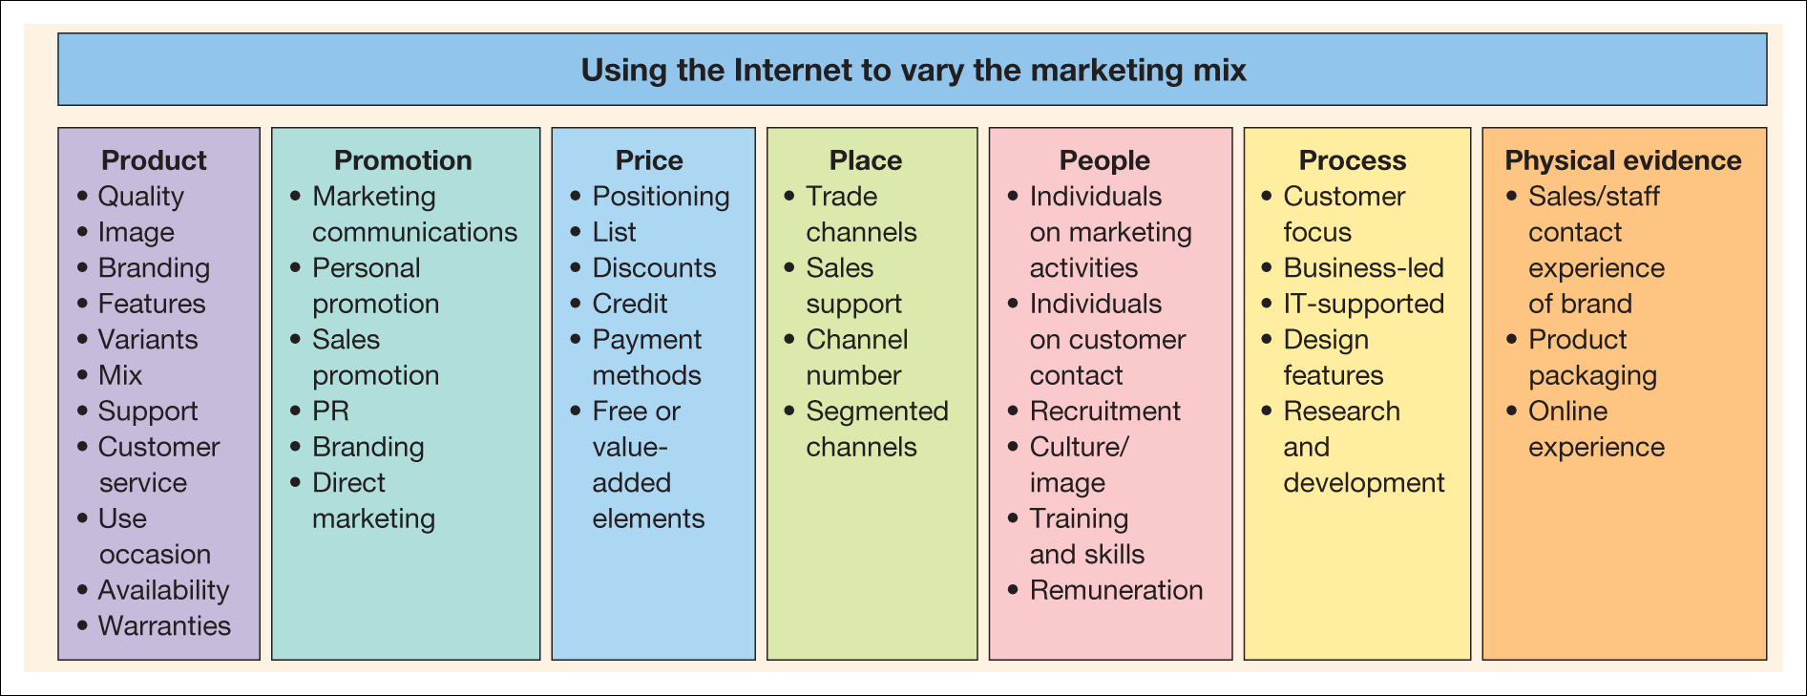
Figure 5.1 The elements of the marketing mix

Slide 7
Product
‘The element of the marketing mix that involves researching customers’ needs and developing appropriate products.’
Core product
  The fundamental features of the product that meet the user’s needs.
Extended product
  Additional features and benefits beyond the core product.

Slide 8
Core product options
Ghosh (1998) Digital value
Rayport and Sviokla (1994) describe transactions where the actual product has been replaced by information about the product
Mass customisation – Levi
Extent of product
  Subset – WHS iDTV
  Bundling – easyJet
Product info more readily available (Allen and Fjermestad, 2001).

Slide 9
Extended product options
Examples:
  Add-on services – gift wrapping @ Amazon
  Endorsements
  Awards
  Testimonies
  Customer lists
  Customer comments
  Warranties
  Guarantees
  Money back offers
  Customer service (see people, process and physical evidence)
  Incorporating tools to help users during their use of the product
  Citroën exCeed
  Information – extranets.

Slide 10
Conducting marketing research online
Online focus group
Online survey
Customer feedback or forums, possibly on independent sites
Web logs.

Slide 11
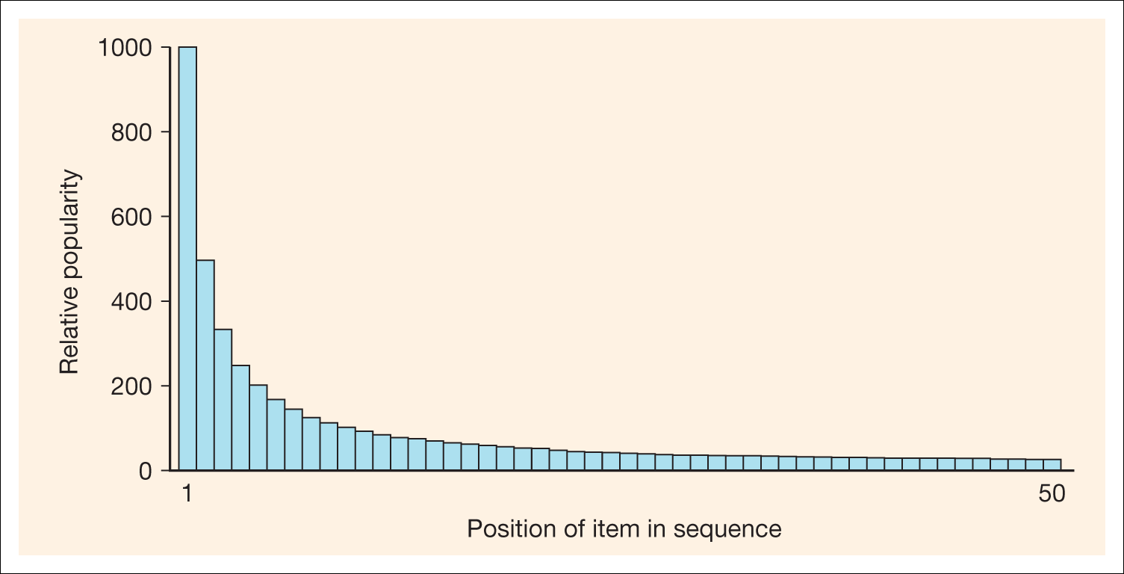
Figure 5.2 Zipf’s law, showing decrease in popularity of items within an ordered
sequence

Slide 12
Brands
A brand is described by Leslie de Chernatony and Malcolm McDonald in their classic book 1992, Creating Powerful Brands as:
‘An identifiable product or service augmented in such a way that the buyer or user perceives relevant unique added values which match their needs most closely. Furthermore, its success results from being able to sustain these added values in the face of competition’.

Slide 13
Brands online
Dayal et al. (2000) say, ‘on the world wide web, the brand is the experience and the experience is the brand’. They suggest that to build successful online brands, organisations should consider how their proposition can build on these possible brand promises:
  The promise of convenience – making a purchase experience more convenient than the real-world, or for rivals.
  The promise of achievement – to assist consumers in achieving their goals, for example supporting online investors in their decision or supporting business people in their day-to-day work.
  The promise of fun and adventure – this is clearly more relevant for B2C services.
  The promise of self-expression and recognition – provided by personalisation services such as Yahoo! Geocities where consumers can build their own website.
  The promise of belonging – provided by online communities.
Plus trust and reassurance.

Slide 14
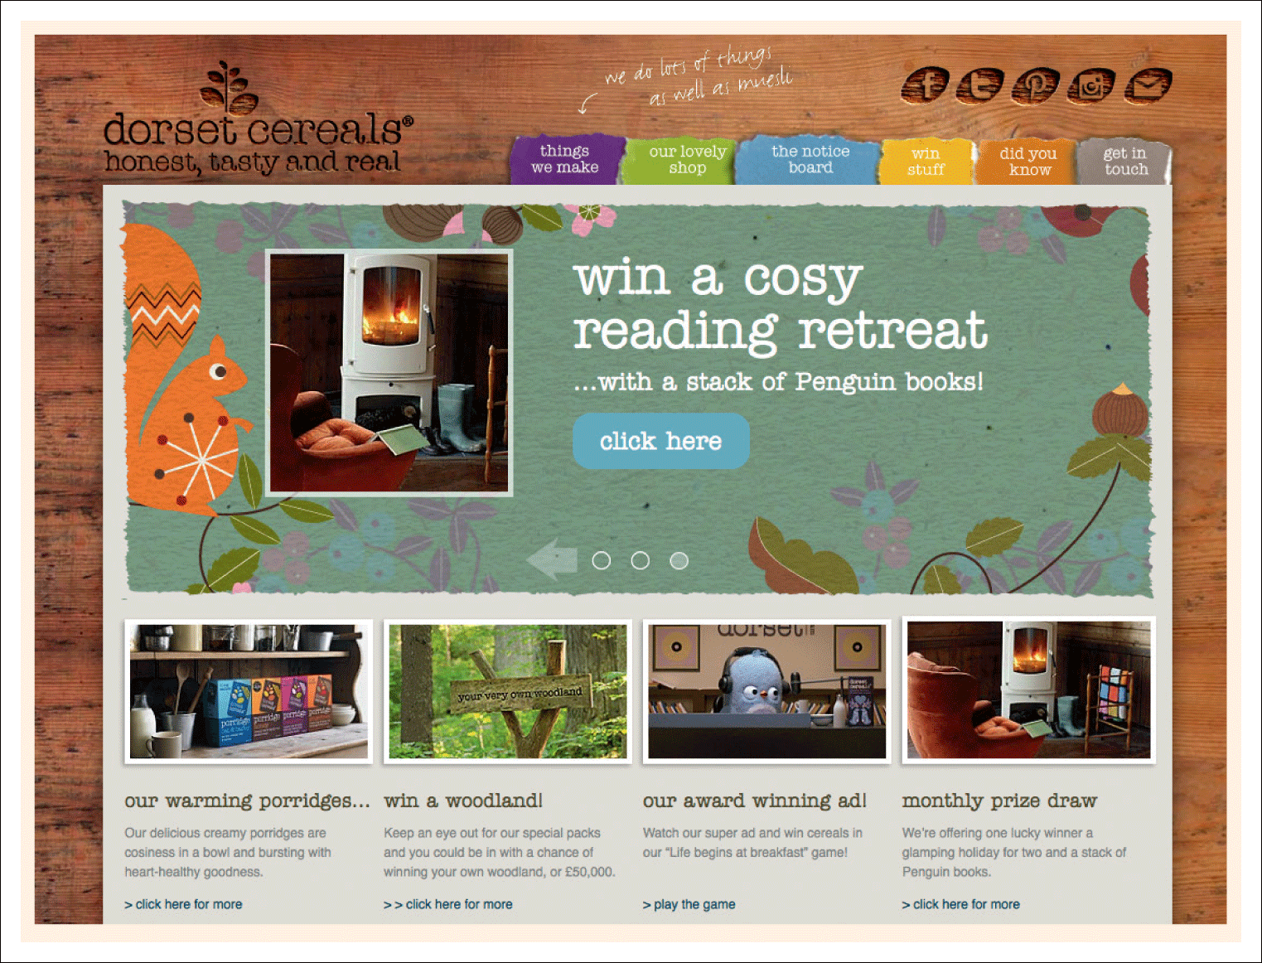
Figure 5.3 Dorset Cereals website (www.dorsetcereals.co.uk)

Slide 15
Price implications
View 1 – decreased prices inevitable
  Price transparency
  Customer knowledge increases
  Price reduction and standardisation
View 2 – decreased prices unnecessary
  89% purchase books from first site
  Only 10% are aggressive bargain hunters
  For corporate buyers internal changes are main benefit
  Amazon, RS prove this?
See Baker et al. (2001)

Slide 16
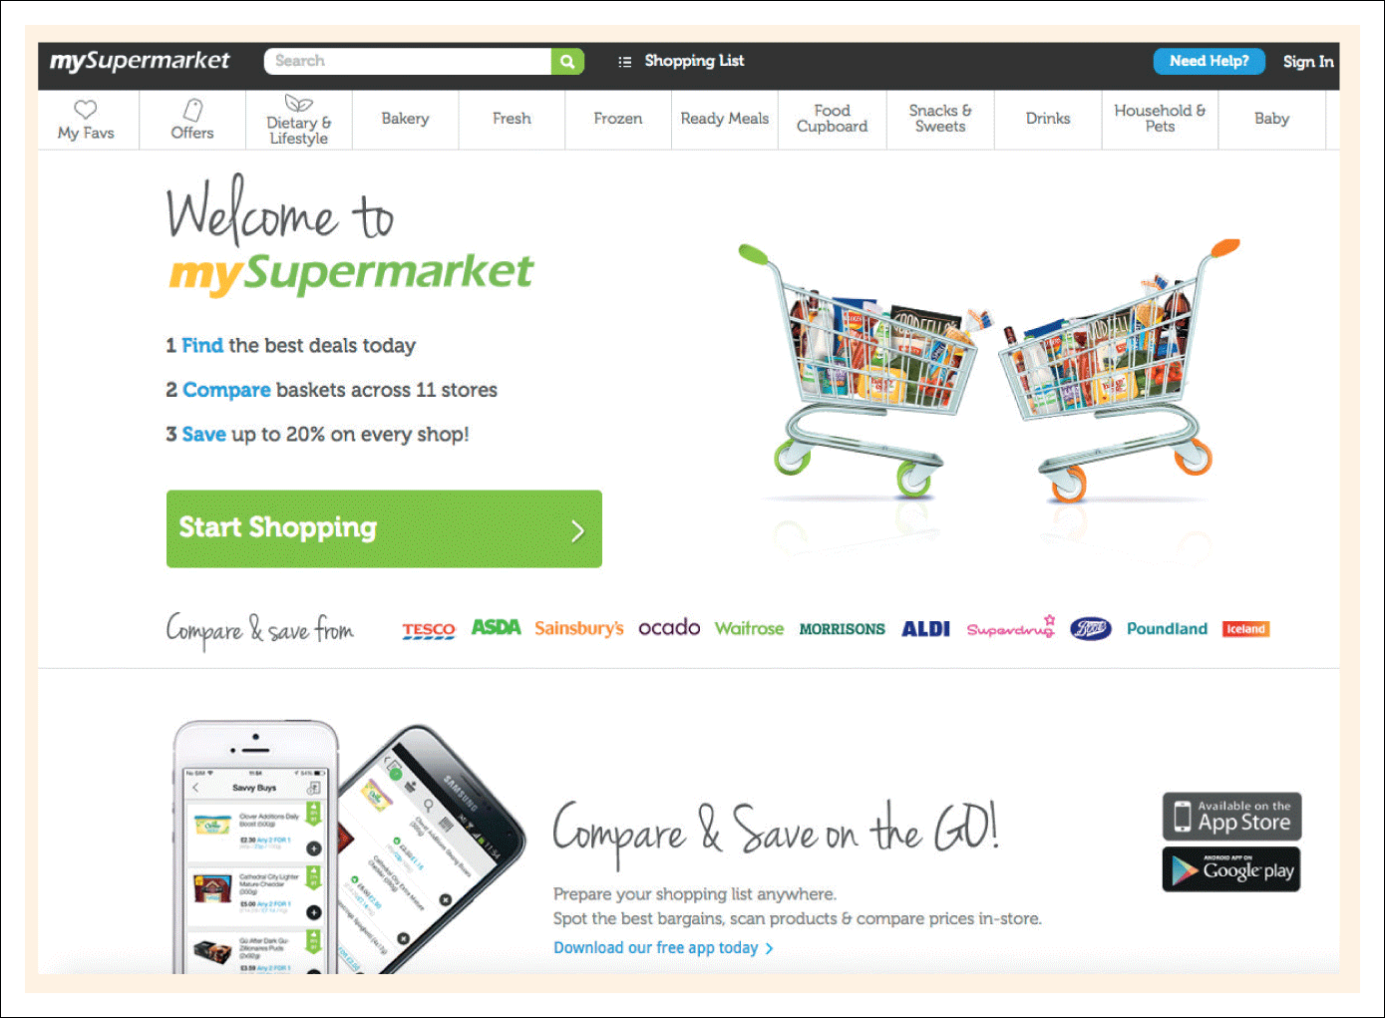
Figure 5.4 My Supermarket aggregator (www.mysupermarket.co.uk)

Slide 17
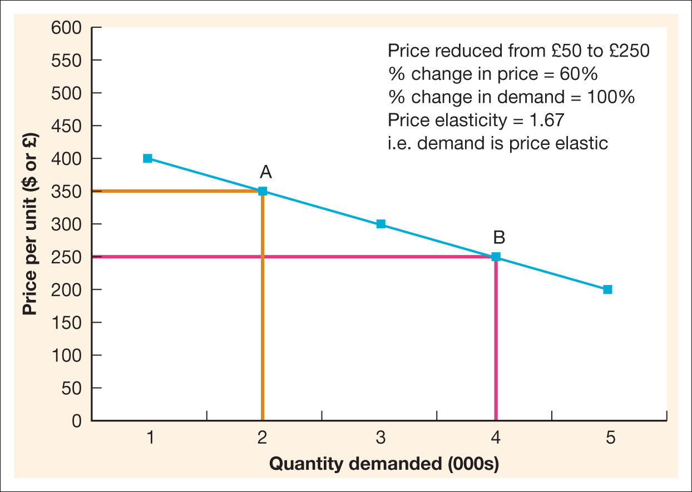
Figure 5.5 Price elasticity of demand for a relatively elastic product

Slide 18
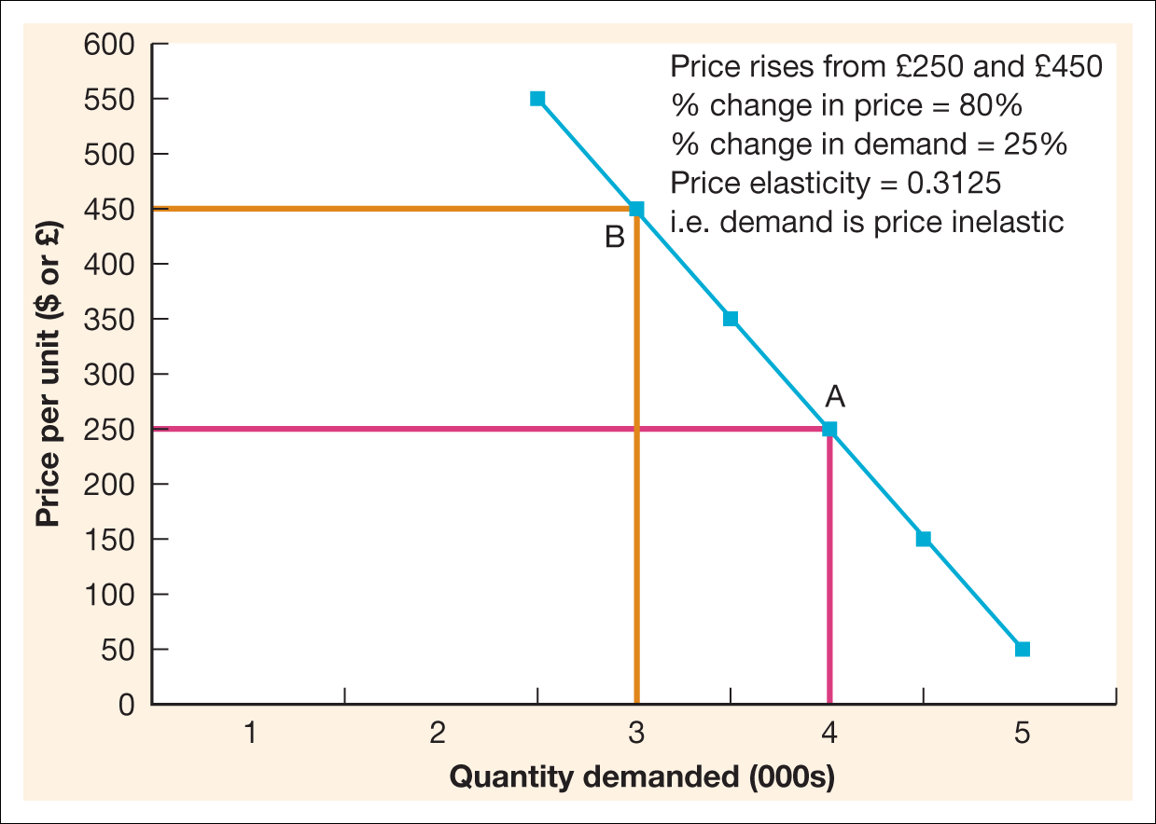
Figure 5.6 Price elasticity of demand for a relatively inelastic product

Slide 19
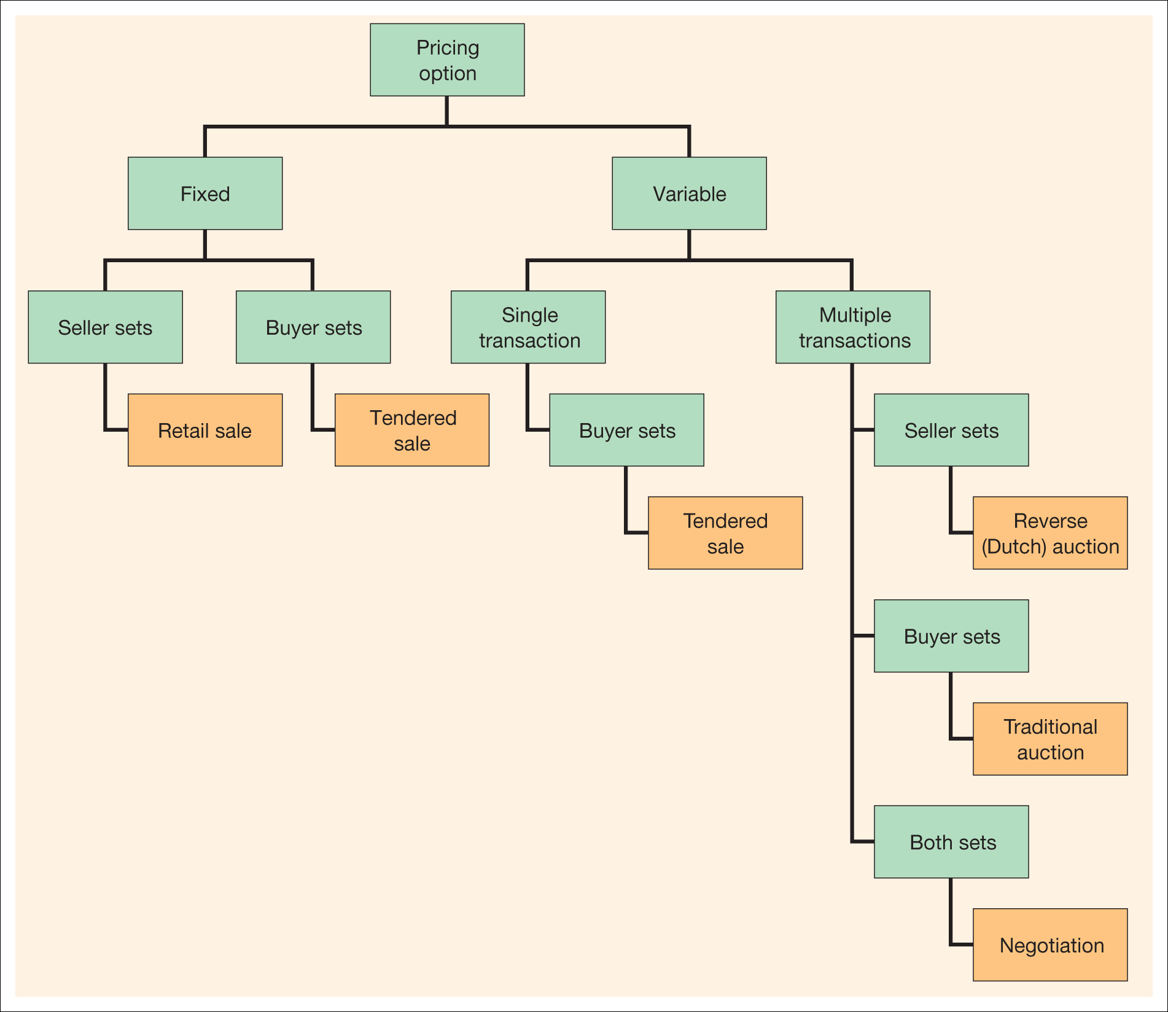
Figure 5.7 Alternative pricing mechanisms

Slide 20
Differential pricing
Options – reduce or transfer. Other options
Precision
  Setting prices more accurately through testing (price indifference band)
  e.g. Zilliant
Adaptability
  Rapid changes (dynamic pricing)
  e.g. Concert tickets
Segmentation
  Different charges according to profiling
  e.g. Ford and core vs fill-in customers.
See Baker et al. (2001)

Slide 21
B2B reverse auctions
Will these become popular?
Yes
  10–20% reductions achievable
No
  Only 2% prefer for B2B
  50% do not choose lowest bidder
  87% stay with current supplier
  Many have stopped experimenting.
See Baker et al. (2001)

Slide 22
Purchase method – digital products
Purchase
Rental or subscription
Pay per use

Slide 23
Pricing options
Cost-plus
  Add profit margin to operational costs
Target profit pricing
  Based on breakeven
Competition-based pricing
Market-oriented
  Premium-pricing
  Penetration pricing.

Slide 24
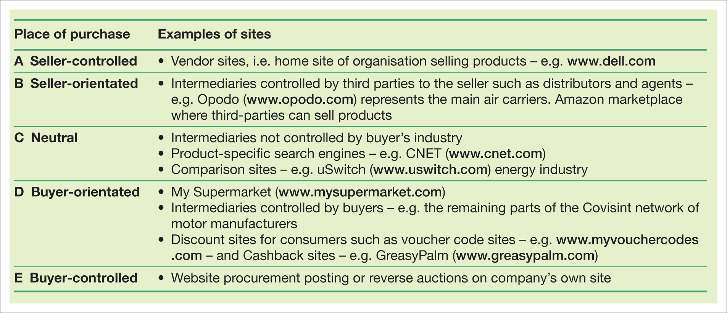
Place 1 – place of purchase
Table 5.2 Different places for virtual marketplace representation

Slide 25
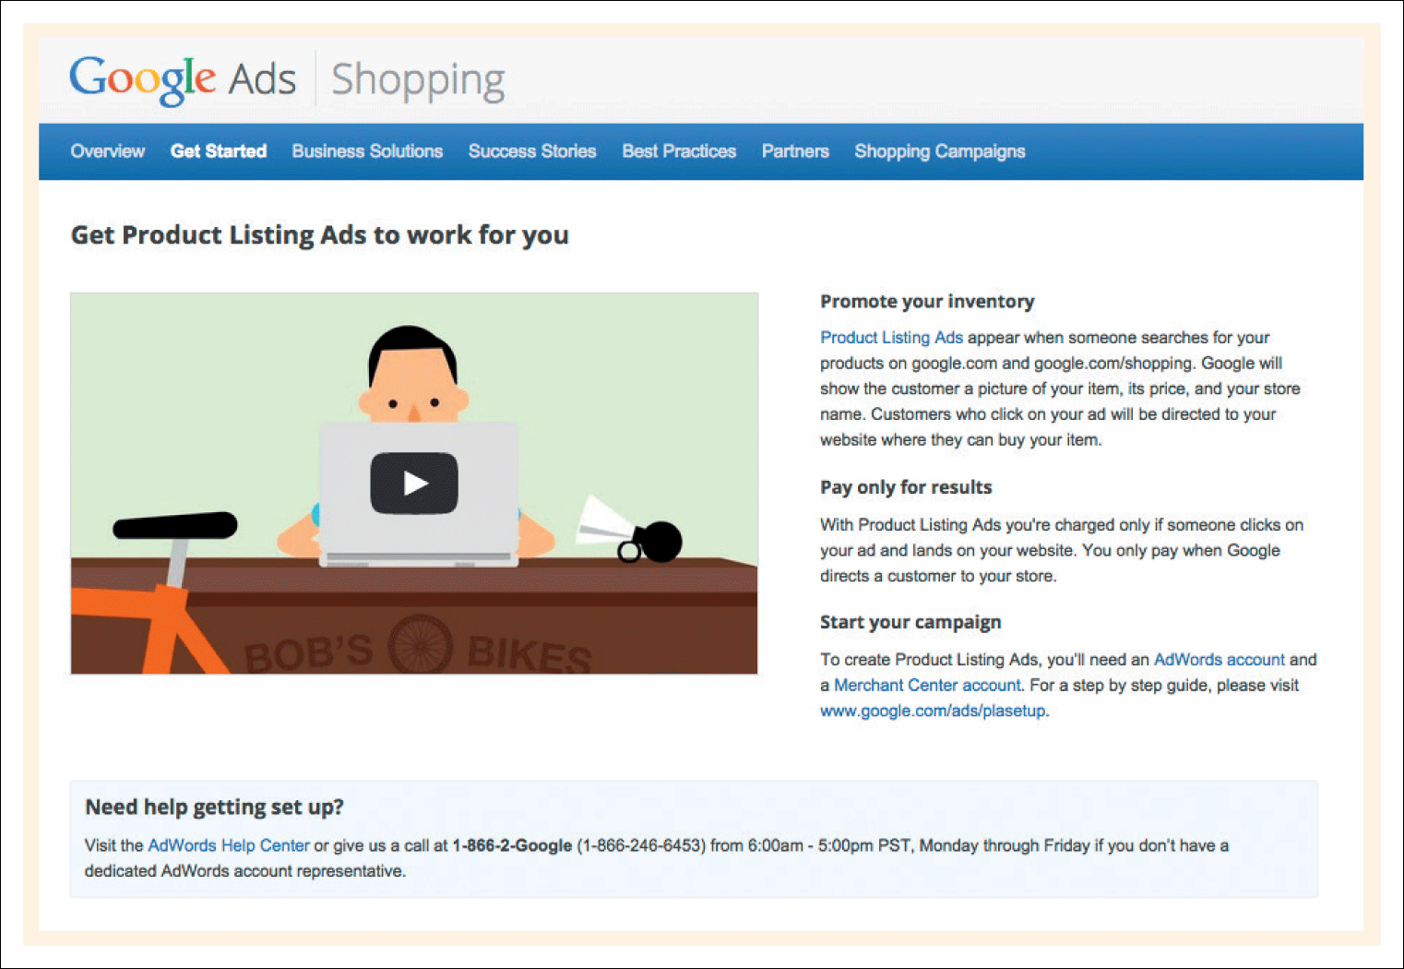
Figure 5.8 Google Product Search (www.google.com/products)

Slide 26
Evans and Wurster view of place
Reach: This is the potential audience of the e-commerce site. Reach can be increased by moving from a single site to representation with a large number of different intermediaries. Allen and Fjermestad suggest that niche suppliers can readily reach a much wider market due to search engine marketing (Chapter 8).
Richness: This is the depth or detail of information which is both collected about the customer and provided to the customer. This is related to the product element of the mix.
Affiliation: This refers to whose interest the selling organisation represents – consumers or suppliers. This particularly applies to retailers. It suggests that customers will favour retailers who provide them with the richest information on comparing competitive products.

Slide 27
Place 2 – new channel structures
A Disintermediation
B Reintermediation
C Countermediation

Slide 28
Place 3 – channel conflicts
Dependent on:
  A communication channel only
  A distribution channel to intermediaries
  A direct sales channel to customers
  Any combination of the above.

Slide 29
Place 4 – virtual organisations – what are they?
Kraut et al. (1998) suggest the following features of a virtual organisation:
  Processes transcend the boundaries of a single form and are not controlled by a single organisational hierarchy.
  Production processes are flexible, with different parties involved at different times.
  Parties involved in the production of a single product are often geographically dispersed.
  Given this dispersion, co-ordination is heavily dependent on telecommunications and data networks.

Slide 30
Virtual organisations – alternatives
Co-alliance model. Effort and risk is shared
equally by partners.
Star-alliance model. Here the effort and risk is centred on one organisation that subcontracts other virtual partners as required.
Value alliance model. This is a partnership where elements are contributed across a supply chain for a particular industry. This is effectively the value network of Chapter 2.
Market alliance model. This is similar to the value alliance, but is more likely to serve several different marketplaces.

Slide 31
Promotion
According to Jobber & Ellis-Chadwick 'Good communications are the life blood of successful market-orientated companies and their brands'.
Digital technology is changing the way individuals and businesses communicate, the channel through which they communicate and the number of touch points encountered.

Slide 32
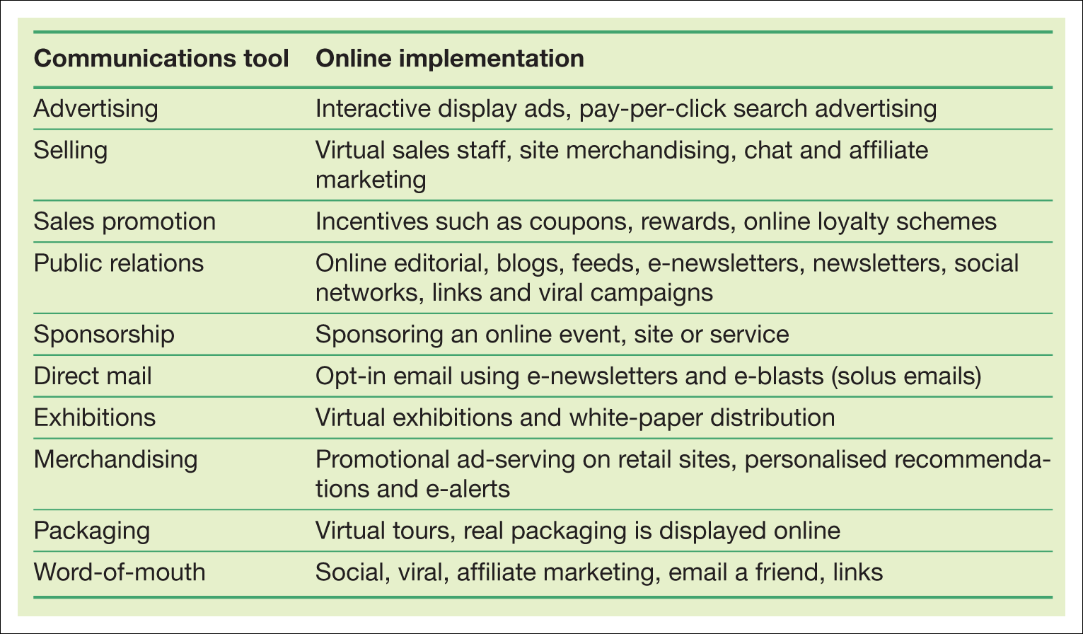
Table 5.3 The main elements of the promotional mix

Slide 33
Promotion tools
Advertising
Sales promotion
Personal selling
Public relations
Direct marketing

Slide 34
Using promotion to vary the mix
Reviewing new ways of applying each of the elements of the communications mix such as advertising, sales promotions, PR and direct marketing.
Assessing how the Internet can be used at different stages of the buying process.
Using promotional tools to assist in different stages of customer relationship management from customer acquisition to retention. In a web context this includes gaining initial visitors to the site and gaining repeat visits through these types of communications techniques:
  Reminders in traditional media campaigns why a site is worth visiting, such as online offers and competions
  Direct e-mail reminders of site proposition – new offers
  Frequently updated content including promotional offers or information that helps your customer do their job or reminds them to visit.

Slide 35
Options for replacing people
Autoresponders. These automatically generate a response when a company e-mails an organisation, or submits an online form.
E-mail notification. Automatically generated by a company’s systems to update customers on the status of their order, for example, order received, item now in stock, order dispatched.
Call-back facility. Customers fill in their phone number on a form and specify a convenient time to be contacted. Dialling from a representative in the call centre occurs automatically at the appointed time and the company pays which is popular.
Frequently Asked Questions (FAQ). For these, the art is in compiling and categorising the questions so customers can easily find (a) the question and (b) a helpful answer.
On-site search engines. These help customers find what they’re looking for quickly and are popular when available. Site maps are a related feature.
Virtual assistants come in varying degrees of sophistication and usually help to guide the customer through a maze of choices.

Slide 36
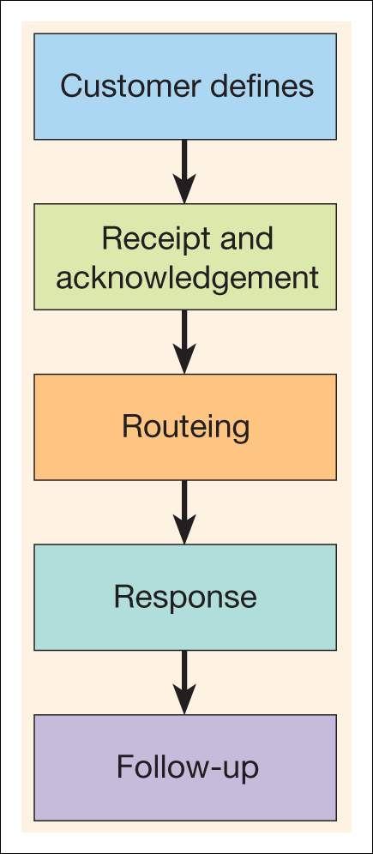
Figure 5.9 Stages in managing inbound email

Slide 37
Methods of managing inbound contacts
Customer defines
  Make contact point clear
  Use FAQ to reduce enquiries (Measure)
  Use drop down lists to categorise query
  Use autoresponse with service promise (number of hours)
  Give alternative information source (phone or web page)
Receipt and
acknowledgement
Routeing
  Large organisations use intelligent software to categorise and prioritise messages and forward them to relevant staff
Response
  Use templates for common responses
  Answer ALL of the questions
  Add question to knowledge base
Follow-up
Offer callback or follow up for key enquiries
Use phone if e-mail is not solving problem

Slide 38
- Terima Kasih -

