Slide 1

    Frequent Itemset Mining
    and The Apriori algorithm
Philippe Fournier-Viger
http://www.philippe-Fournier-viger.com
R. Agrawal and R. Srikant. Fast algorithms for mining association rules in large databases. Research Report RJ 9839, IBM Almaden Research Center, San Jose, California, June 1994.
Source code and datasets available in the SPMF library
Notes:
Fournier-Viger, P., Wu, C.-W., Gomariz, A., Tseng, V. S. (2014). VMSP: Efficient Vertical Mining of Maximal Sequential Patterns. Proc. 27th Canadian Conference on Artificial Intelligence (AI 2014), Springer, LNAI, pp. 83-94.
It’s not really about « APPLICATIONS OF AI »

Slide 2
Introduction
Many retail stores collect data about customers.
e.g. customer transactions
Need to analyze this data to understand customer behavior
Why?
  for marketing purposes,
  inventory management,
  customer relationship management

Slide 3
Introduction
Discovering patterns and associations
Discovering interesting relationships hidden in large databases.
e.g. beer and diapers are often sold together
pattern mining is a fundamental data mining problem with many applications in various fields.
Introduced by Agrawal (1993).
Many extensions of this problem to discover patterns in graphs, sequences, and other kinds of data.

Slide 4
Frequent itemset mINING

Slide 5
Definitions
Let $I=\left\{I1, I2, … Im\right\}$ be the set of items (products) sold in a retail store.
For example:
I= {pasta, lemon, bread, orange, cake}

Slide 6
Definitions
A transaction database D is a set of transactions.
D = {T_{1,} T_{2,} … T_{r}} such t$hat Ta⊆I (1≤a≤r).$
Transaction | Items appearing in the transaction
T1 | {pasta, lemon, bread, orange}
T2 | {pasta, lemon}
T3 | {pasta, orange, cake}
T4 | {pasta, lemon, orange, cake}

Slide 7
Definitions
Each transaction has a unique identifier called its
Transaction ID (TID).
e.g. the transaction ID of T₄ is 4.
Transaction | Items appearing in the transaction
T1 | {pasta, lemon, bread, orange}
T2 | {pasta, lemon}
T3 | {pasta, orange, cake}
T4 | {pasta, lemon, orange, cake}

Slide 8
Definitions
A transaction is a set of items (an itemset).
e.g. T2= {pasta, lemon}
An item (a symbol) may not appear or appear once in each transaction. Each transaction is unordered.
Transaction | Items appearing in the transaction
T1 | {pasta, lemon, bread, orange}
T2 | {pasta, lemon}
T3 | {pasta, orange, cake}
T4 | {pasta, lemon, orange, cake}

Slide 9
Definitions
A transaction database can be viewed as a binary matrix:
Transaction | pasta | lemon | bread | orange | cake
T1 | 1 | 1 | 1 | 1 | 0
T2 | 1 | 1 | 0 | 0 | 0
T3 | 1 | 0 | 0 | 1 | 1
T4 | 1 | 1 | 0 | 1 | 1
Asymetrical binary attributes (because 1 is more important than 0)
There is no information about purchase quantities and prices.

Slide 10
Definitions
Let I bet the set of all items:
I= {pasta, lemon, bread, orange, cake}
There are 2^{|I|} – 1 = 2⁵ – 1 = 31 subsets :
{pasta}, {lemon}, {bread}, {orange}, {cake}
{pasta, lemon}, {pasta, bread} {pasta, orange}, {pasta, cake}, {lemon, bread}, {lemon orange},
{lemon, cake}, {bread, orange}, {bread cake}
…
{pasta, lemon, bread, orange, cake}

Slide 11
Definitions
An itemset is said to be of size k, if it contains k items.
Itemsets of size 1:
{pasta}, {lemon}, {bread}, {orange}, {cake}
Itemsets of size 2:
{pasta, lemon}, {pasta, bread} {pasta, orange}, {pasta, cake}, {lemon, bread}, {lemon orange}, …

Slide 12
Definitions
The support (frequency) of an itemset X is the number of transactions that contains X.
sup(X) = |{$T | X⊆T∧T∈D\}|$
For example: The support of {pasta, orange} is 3.
which is written as: sup({pasta, orange}) = 3
Transaction | Items appearing in the transaction
T1 | {pasta, lemon, bread, orange}
T2 | {pasta, lemon}
T3 | {pasta, orange, cake}
T4 | {pasta, lemon, orange, cake}
support = 支持

Slide 13
Definitions
The support of an itemset X can also be written as a ratio (absolute support).
Example: The support of {pasta, orange} is 75% because it appears in 3 out of 4 transactions.
Transaction | Items appearing in the transaction
T1 | {pasta, lemon, bread, orange}
T2 | {pasta, lemon}
T3 | {pasta, orange, cake}
T4 | {pasta, lemon, orange, cake}

Slide 14
The problem of frequent itemset mining
Let there be a numerical value minsup, set by the user.
Frequent itemset mining (FIM) consists of enumerating all frequent itemsets, that is itemsets having a support greater or equal to minsup.
Transaction | Items appearing in the transaction
T1 | {pasta, lemon, bread, orange}
T2 | {pasta, lemon}
T3 | {pasta, orange, cake}
T4 | {pasta, lemon, orange, cake}

Slide 15
Example
Transaction | Items appearing in the transaction
T1 | {pasta, lemon, bread, orange}
T2 | {pasta, lemon}
T3 | {pasta, orange, cake}
T4 | {pasta, lemon, orange cake}
For minsup = 2, the frequent itemsets are:
{lemon}, {pasta}, {orange}, {cake}, {lemon, pasta}, {lemon, orange}, {pasta, orange}, {pasta, cake}, {orange, cake}, {lemon, pasta, orange}
For the user, choosing a high minsup value,
will reduce the number of frequent itemsets,
will increase the speed and decrease the memory required for finding the frequent itemsets

Slide 16
Numerous applications
Frequent itemset mining has numerous applications.
  medical applications,
  chemistry,
  biology,
  e-learning,
  etc.

Slide 17
Several algorithms
Algorithms:
  Apriori, AprioriTID (1993)
  Eclat (1997)
  FPGrowth (2000)
  Hmine (2001)
  LCM, …
  …
Moreover, numerous extensions of the FIM problem: uncertain data, fuzzy data, purchase quantities, profit, weight, time, rare itemsets, closed itemsets, etc.

Slide 18
Algorithms

Slide 19
Naïve approach
If there are n items in a database, there are 2^{n} -1 itemsets may be frequent.
Naïve approach: count the support of all these itemsets.
To do that, we would need to read each transaction in the database to count the support of each itemset.
This would be inefficient:
  need to perform too many comparisons
  requires too much memory

Slide 20
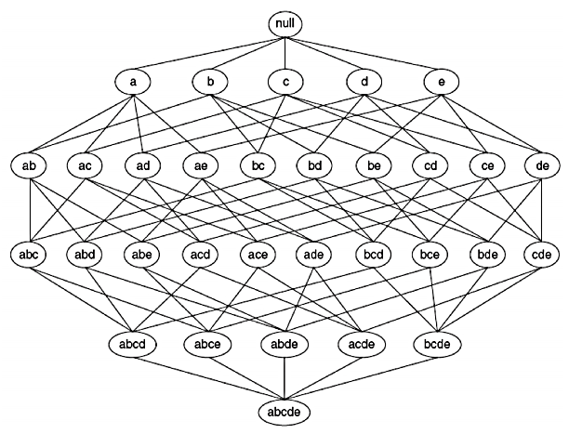
Search space
This is all the itemsets that can be formed with the items
lemon (l), pasta (p), bread (b), orange (o) and cake (c)
$$∅$$
l
p
b
o
c
lp
lb
lo
lc
pb
po
pc
bo
bc
oc
lpb
lpo
lpc
lbo
lbc
loc
pbo
pbc
poc
boc
l = lemon
p = pasta
b = bread
0 = orange
c = cake
lpbo
lpbc
lpoc
lboc
pboc
lpboc
This form a lattice, which can be viewed as a Hasse diagram

Slide 21
Search space
If minsup = 2, the frequent itemsets are (in yellow):
$$∅$$
l
p
b
o
c
lp
lb
lo
lc
pb
po
pc
bo
bc
oc
lpb
lpo
lpc
lbo
lbc
loc
pbo
pbc
poc
boc
l = lemon
p = pasta
b = bread
0 = orange
c = cake
lpbo
lpbc
lpoc
lboc
pboc
lpboc

Slide 22

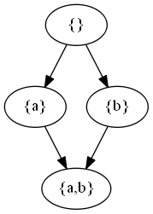
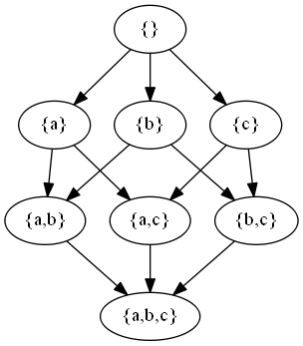
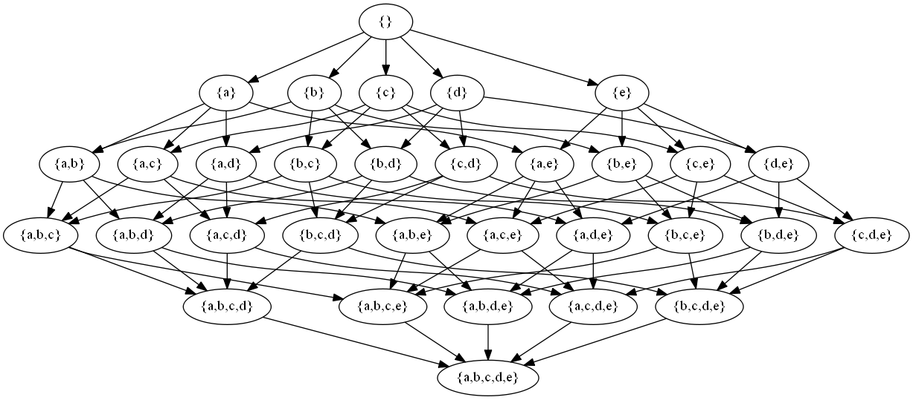
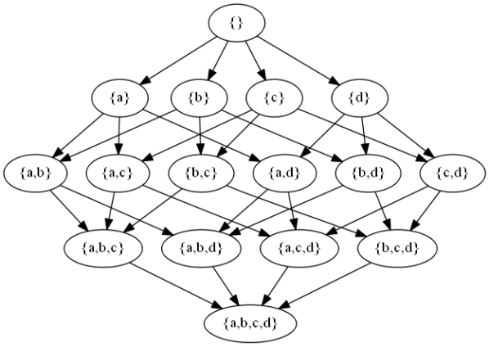
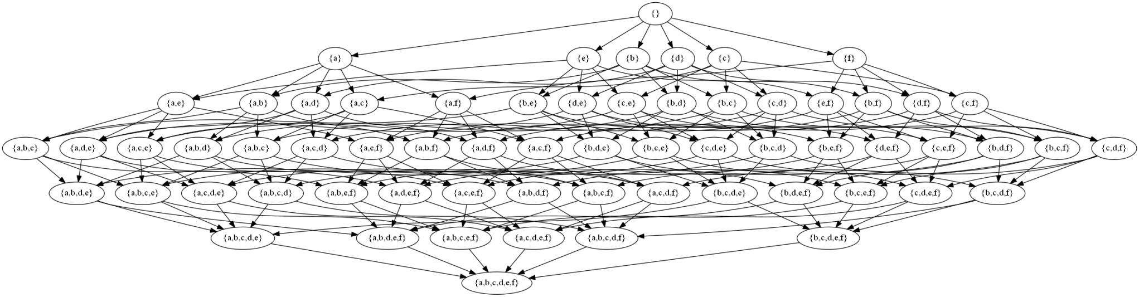
I={A}
I={A, B}
I={A, B,C}
I={A, B,C,D}
I={A, B,C,D,E}
I={A, B,C,D,E,F}

Slide 23
How to find the frequent itemsets?
Two challenges:
How to count the support of itemsets in an efficient way (not spend too much time or memory)?
How to reduce the search space (we do not want to consider all the possibilities)?

Slide 24
The APRIORI algorithm
(Agrawal & Srikant, 1993/1994)
R. Agrawal and R. Srikant. Fast algorithms for mining association rules in large databases. Research Report RJ 9839, IBM Almaden Research Center, San Jose, California, June 1994.

Slide 25
Introduction
Apriori is a famous algorithm
which is not the most efficient algorithm,
but has inspired many other algorithms!
has been applied in many fields,
has been adapted for many other similar problems.
Apriori is based on two important properties

Slide 26
Apriori property: Let there be two itemsets X and Y.
If X $⊂Y,$the support of Y is less than or equal to the support of X.
Example:
The support of {pasta} is 4
The support of {pasta, lemon} is 3
The support of {pasta, lemon, orange} is 2
Transaction | Items appearing in the transaction
T1 | {pasta, lemon, bread, orange}
T2 | {pasta, lemon}
T3 | {pasta, orange, cake}
T4 | {pasta, lemon, orange, cake}
(support is anti-monotonic)

Slide 27
Illustration
$$∅$$
minsup =2
l
p
b
o
c
frequent itemsets
lp
lb
lo
lc
pb
po
pc
bo
bc
oc
lpb
lpo
lpc
lbo
lbc
loc
pbo
pbc
poc
boc
Infrequent
itemsets
lpbo
lpbc
lpoc
lboc
pboc
lpboc

Slide 28
This property is useful to reduce the search space. Example:
If « bread » is infrequent
$$∅$$
minsup =2
l
p
b
o
c
lp
lb
lo
lc
pb
po
pc
bo
bc
oc
lpb
lpo
lpc
lbo
lbc
loc
pbo
pbc
poc
boc
lpbo
lpbc
lpoc
lboc
pboc
lpboc

Slide 29
This property is useful to reduce the search space. Example:
If « bread » is infrequent, all its supersets are infrequent.
$$∅$$
minsup =2
l
p
b
o
c
lp
lb
lo
lc
pb
po
pc
bo
bc
oc
lpb
lpo
lpc
lbo
lbc
loc
pbo
pbc
poc
boc
lpbo
lpbc
lpoc
lboc
pboc
lpboc

Slide 30
Property 2: Let there be an itemset Y.
If there exists an itemset X $⊂Y$such that X is infrequent, then Y is infrequent.
Example:
Consider {bread, lemon}.
If we know that {bread} is infrequent, then we can infer that {bread, lemon} is also infrequent.
Transaction | Items appearing in the transaction
T1 | {pasta, lemon, bread, orange}
T2 | {pasta, lemon}
T3 | {pasta, orange, cake}
T4 | {pasta, lemon, orange, cake}

Slide 31
The Apriori algorithm
I will now explain how the Apriori algorithm works
Input:
  minsup
  a transactional database
Output:
  all the frequent itemsets
Consider minsup =2.

Slide 32
The Apriori algorithm
Step 1: scan the database to calculate the support of all itemsets of size 1.
e.g.
{pasta} support = 4
{lemon} support = 3
{bread} support = 1
{orange} support = 3
{cake} support = 2

Slide 33
The Apriori algorithm
Step 2: eliminate infrequent itemsets.
e.g.
{pasta} support = 4
{lemon} support = 3
{bread} support = 1
{orange} support = 3
{cake} support = 2

Slide 34
The Apriori algorithm
Step 2: eliminate infrequent itemsets.
e.g.
{pasta} support = 4
{lemon} support = 3
{orange} support = 3
{cake} support = 2

Slide 35
The Apriori algorithm
Step 3: generate candidates of size 2 by combining pairs of frequent itemsets of size 1.
Candidates of size 2
{pasta, lemon}
{pasta, orange}
{pasta, cake}
{lemon, orange}
{lemon, cake}
{orange, cake}
Frequent items
{pasta}
{lemon}
{orange}
{cake}

Slide 36
The Apriori algorithm
Step 4: Eliminate candidates of size 2 that have an infrequent subset (Property 2)
(none!)
Candidates of size 2
{pasta, lemon}
{pasta, orange}
{pasta, cake}
{lemon, orange}
{lemon, cake}
{orange, cake}
Frequent items
{pasta}
{lemon}
{orange}
{cake}

Slide 37
The Apriori algorithm
Step 5: scan the database to calculate the support of remaining candidate itemsets of size 2.
Candidates of size 2
{pasta, lemon} support: 3
{pasta, orange} support: 3
{pasta, cake} support: 2
{lemon, orange} support: 2
{lemon, cake} support: 1
{orange, cake} support: 2

Slide 38
The Apriori algorithm
Step 6: eliminate infrequent candidates of size 2
Candidates of size 2
{pasta, lemon} support: 3
{pasta, orange} support: 3
{pasta, cake} support: 2
{lemon, orange} support: 2
{lemon, cake} support: 1
{orange, cake} support: 2

Slide 39
The Apriori algorithm
Step 6: eliminate infrequent candidates of size 2
Frequent itemsets of size 2
{pasta, lemon} support: 3
{pasta, orange} support: 3
{pasta, cake} support: 2
{lemon, orange} support: 2
{orange, cake} support: 2

Slide 40
The Apriori algorithm
Step 7: generate candidates of size 3 by combining frequent pairs of itemsets of size 2.
Candidates of size 3
Frequent itemsets of size 2
{pasta, lemon, orange}
{pasta, lemon, cake}
{pasta, orange, cake}
{lemon, orange, cake}
{pasta, lemon}
{pasta, orange}
{pasta, cake}
{lemon, orange}
{orange, cake}

Slide 41
The Apriori algorithm
Step 8: eliminate candidates of size 3 having a subset of size 2 that is infrequent.
Candidates of size 3
Frequent itemsets of size 2
{pasta, lemon, orange}
{pasta, lemon, cake}
{pasta, orange, cake}
{lemon, orange, cake}
{pasta, lemon}
{pasta, orange}
{pasta, cake}
{lemon, orange}
{orange, cake}
Because {lemon, cake} is infrequent!

Slide 42
The Apriori algorithm
Step 8: eliminate candidates of size 3 having a subset of size 2 that is infrequent.
Candidates of size 3
Frequent itemsets of size 2
{pasta, lemon, orange}
{pasta, orange, cake}
{pasta, lemon}
{pasta, orange}
{pasta, cake}
{lemon, orange}
{orange, cake}
Because {lemon, cake} is infrequent!

Slide 43
The Apriori algorithm
Step 9: scan the database to calculate the support of the remaining candidates of size 3.
Candidates of size 2
{pasta, lemon, orange} support: 2
{pasta, orange, cake} support: 2

Slide 44
The Apriori algorithm
Step 10: eliminate infrequent candidates (none!)
frequent itemsets of size 3
{pasta, lemon, orange} support: 2
{pasta, orange, cake} support: 2

Slide 45
The Apriori algorithm
Step 11: generate candidates of size 4 by combining pairs of frequent itemsets of size 3.
Candidates of size 4
Frequent itemsets of size 3
{pasta, lemon, orange}
{pasta, orange, cake}
{pasta, lemon, orange, cake}

Slide 46
The Apriori algorithm
Step 12: eliminate candidates of size 4 having a subset of size 3 that is infrequent.
Candidates of size 4
Frequent itemsets of size 3
{pasta, lemon, orange}
{pasta, orange, cake}
{pasta, lemon, orange, cake}

Slide 47
The Apriori algorithm
Step 12: Since there is no more candidates, we cannot generate candidates of size 5 and the algorithm stops.
Candidates of size 4
{pasta, lemon, orange, cake}
Result →

Slide 48
Final result
{pasta} support = 4
{lemon} support = 3
{orange} support = 3
{cake} support = 2
{pasta, lemon} support: 3
{pasta, orange} support: 3
{pasta, cake} support: 2
{lemon, orange} support: 2
{orange, cake} support: 2
{pasta, lemon, orange} support: 2
{pasta, orange, cake} support: 2

Slide 49
Technical details
Combining different itemsets can generate the same candidate.
Example:
{A, B} and { A,E} → {A, B, E}
{B, E} and { A,E} → {A, B, E}
problem: some candidates are generated several times!

Slide 50
Technical details
Combining different itemsets can generate the same candidate.
Example:
{A, B} and { A,E} → {A, B, E}
{B, E} and { A,E} → {A, B, E}
Solution:
Sort items in each itemsets (e.g. by alphabetical order)
Combine two itemsets only if all items are the same except the last one.

Slide 51
Apriori vs the naïve algorithm
The Apriori property can considerably reduce the number of itemsets to be considered.
In the previous example:
  Naïve approach:
  2⁵-1 = 31 itemsets are considered
  By using the Apriori property:
    18 itemsets are considered

Slide 52
Algorithm is a correct and complete algorithm
It is complete: it can find all frequent itemsets
It is correct: it does not find any itemsets that are infrequent.
I will not show the proof.

Slide 53
Performance comparison

Slide 54
How to evaluate this type of algorithms?
Execution time,
Memory used,
Scalability: how the performance is influenced by the number of transactions
Performance on different types of data:
  real data,
  synthetic (fake) data,
  dense vs sparse data,…
…

Slide 55
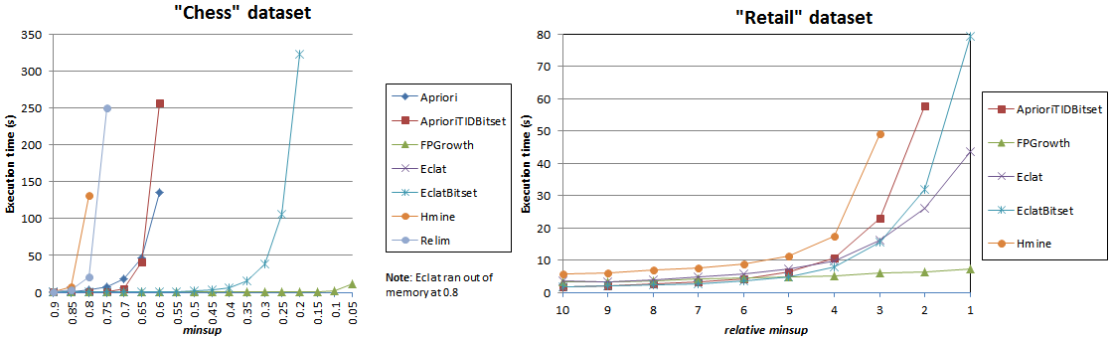
Performance (execution time)

Slide 56
Performance (execution time)

Slide 57
Performance of Apriori
The performance of Apriori depends on several factors:
the minsup parameter: the more it is set low, the larger the search space and the number of itemsets will be.
the number of items,
the number of transactions,
The average transaction length.

Slide 58
Problems of Apriori
can generate numerous candidates
requires to scan the database numerous times.
candidates may not exist in the database.
…

Slide 59
A few optimizations for the APRIORI algorithm
This is an advanced topic

Slide 60
Optimization 1
In terms of data structure:
Store all items as integers:
e.g. 1= pasta, 2= orange, 3= bread…
Why?
  it is faster to compare two integers than to compare two character strings,
  requires less memory.

Slide 61
Optimization 2
To reduce the time required to calculate the support of itemsets
To calculate the support of an itemset of size k, only the transactions of size >= k are used.
Transaction | Items appearing in the transaction
T2 | {pasta, lemon}
T3 | {pasta, orange, cake}
T4 | {pasta, lemon, orange, cake}
T1 | {pasta, lemon, bread, orange}
sort transactions by ascending length

Slide 62
Optimization 3
To reduce the time required to calculate the support of itemsets
Replace all identical transactions by a single transactions with a weight.

Slide 63
Optimization 4
To reduce the time require to calculate the support of itemsets:
Sort items in transactions according to a total order (e.g. alphabetical order).
Utilize binary search to quickly check if an item appears in a transaction.

Slide 64
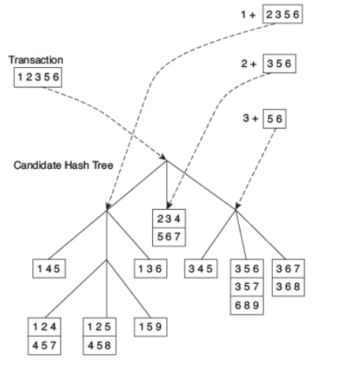
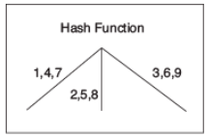
Optimization 5
Store candidates in a hash tree
To calculate the support of candidates
  Calculate a hash value based on a transaction to determine if candidates are contained in thetransaction.

Slide 65
Other optimizations
Sampling and partitioning

Slide 66
AprioriTID: a varition
AprioriTID:
Annotate each itemset with the ids of transactions that contain it,
use the intersection ($∩$) to calculate the support of itemsets instead of reading the database.
Example →

Slide 67
Transaction | Items appearing in the transaction
T1 | {pasta, lemon, bread, orange}
T2 | {pasta, lemon}
T3 | {pasta, orange, cake}
T4 | {pasta, lemon, orange, cake}
item | transactions containing the item
pasta | T1, T2, T3, T4
lemon | T1, T2, T3
bread | T1
orange | T1, T3, T4
cake | T3, T4

Slide 68
item | transactions containing the item
pasta | T1, T2, T3, T4
lemon | T1, T2, T4
bread | T1
orange | T1, T3, T4
cake | T3, T4
Example: calculating the support of{pasta, lemon} :
transactions({pasta}) $∩$ transactions({lemon})
= {T1, T2, T3, T4} $∩$ {T1, T2, T4}
= {T1, T2, T4 }
Thus {pasta, lemon} has a support of 3

Slide 69
AprioriTID_Bitset
AprioriTID_bitset:
Same idea, except that bit vectors are used instead of lists of ids.
This allows to calculate the intersection using the Logical_AND, which is often very fast.
Example →

Slide 70
Transaction | Items appearing in the transaction
T1 | {pasta, lemon, bread, orange}
T2 | {pasta, lemon}
T3 | {pasta, orange, cake}
T4 | {pasta, lemon, orange, cake}
item | transactions containing the item
pasta | 1111 (representing T1, T2, T3, T4)
lemon | 1101
bread | 1000
orange | 1011
cake | 0011

Slide 71
item | transactions containing the item
pasta | 1111
lemon | 1101
bread | 1000
orange | 1011
cake | 0011
Example: Calculate the support of {pasta, lemon} :
transactions({pasta}) $∩$ transactions({lemon})
= 1$111$LOGICAL_AND 1101
= 1101
Thus {pasta, lemon} has a support of 3

Slide 72
Conclusion
This video has presented:
The problem of frequent itemset mining
The Apriori algorithm
Some optimizations

Slide 73
References
Han and Kamber (2011), Data Mining: Concepts and Techniques, 3rd edition, Morgan Kaufmann Publishers,
Tan, Steinbach & Kumar (2006), Introduction to Data Mining, Pearson education, ISBN-10: 0321321367
…

