Slide 1


Describing Facilities
PERTEMUAN KE 13

Slide 2
Most tourism industry their guests many facilities and amenities for their use and enjoyment. The facilities may include pools, sauna and steam room, a number of restaurants, a health center, tennis courts, program for children, business center, etc. Throughout the course of the day a guest may ask a hotel employee about any one of them. Questions that a guest might have are: does the hotel have a particular facility, where it is located, when are its hours of operation, how much it costs, do the facility staff speak English, etc.

Slide 3
Guest may also ask or places outside industry. Such places may be a diving school, an historical site to visit or a panoramic vista. The list could be endless. The more knowledgeable a staff is about the local facilities and points of interest, the better service they will able to give to the guests.

Slide 4
Below are lists of various facilities or activities that guest may inquire about
At hotel In the community
Lobby Panoramic Vista
Restaurant Shopping mall
Café Snorkeling
Spa Island Tours
Sauna Elephant Treks
Fitness Center Museums
Conference Rooms Open market
Squash Courts Golf
Children Program Zoo
Lounges Sea kayaking
Gift Shops Boat Charters
Business Centers Scuba Diving
Swimming pools Nature Treks

Slide 5
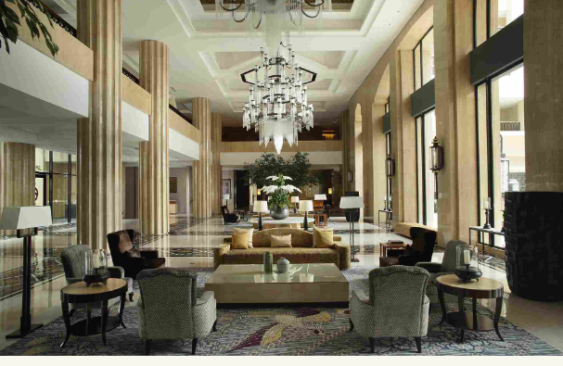
Lobby

Slide 6
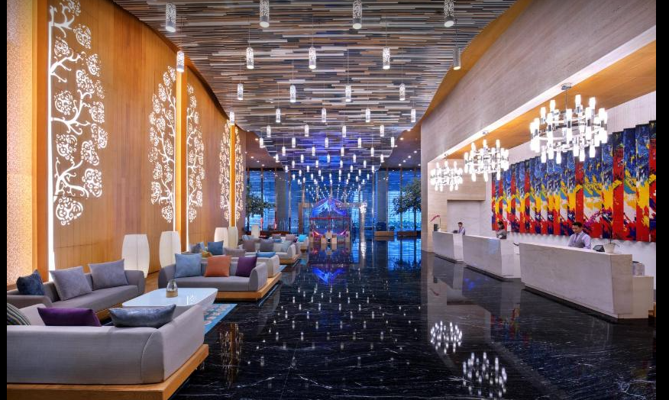
Lobby

Slide 7
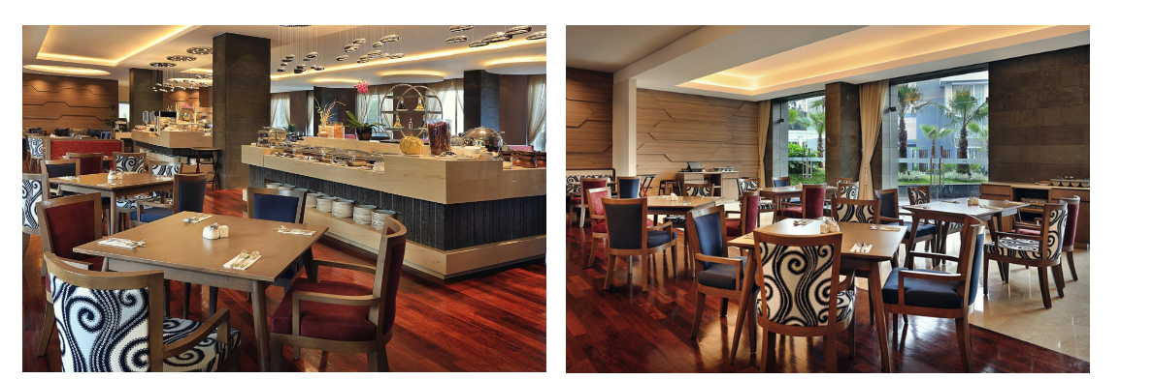
Restaurant

Slide 8
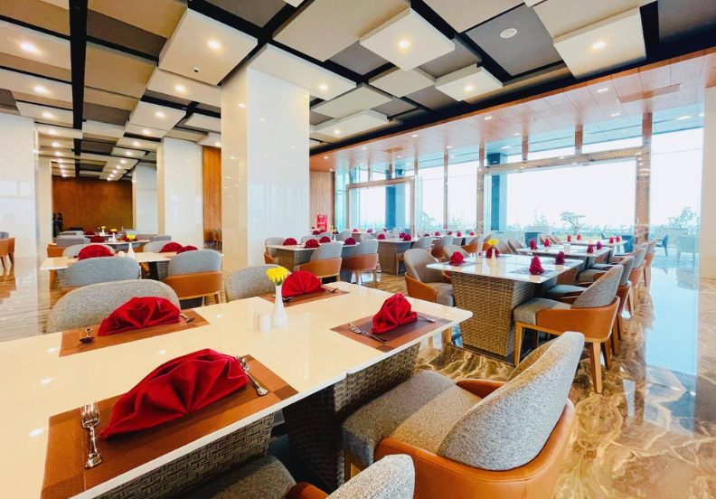
Restaurant

Slide 9
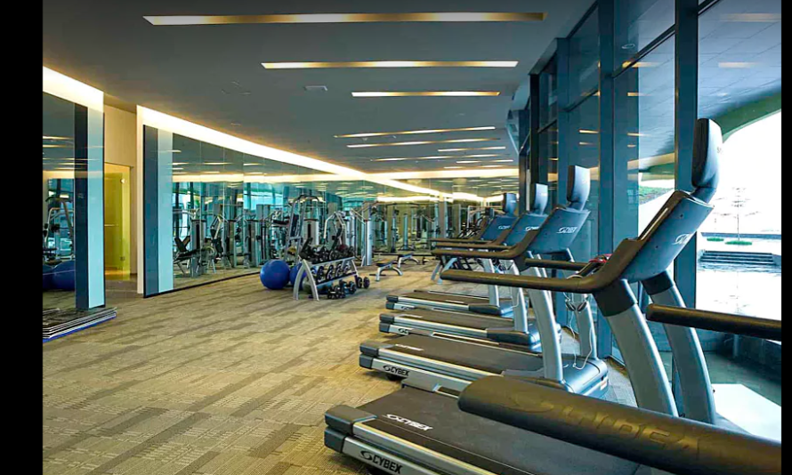
Gym Center

Slide 10
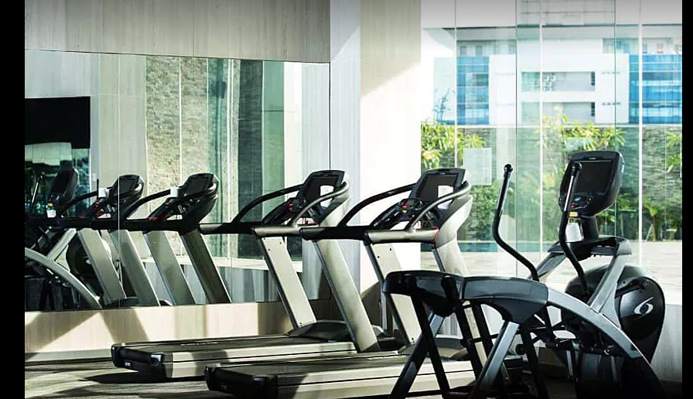
Gym Center

Slide 11
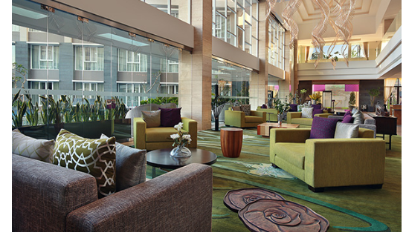
Lounges

Slide 12
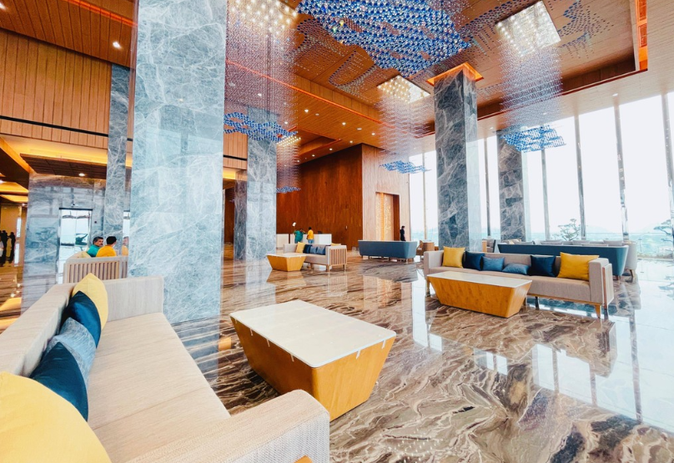
Lounges

Slide 13
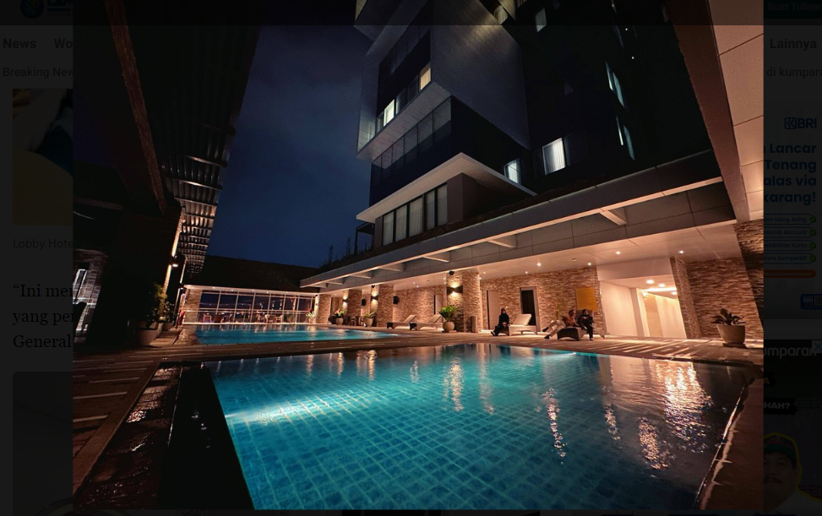
Swimming Pool

Slide 14
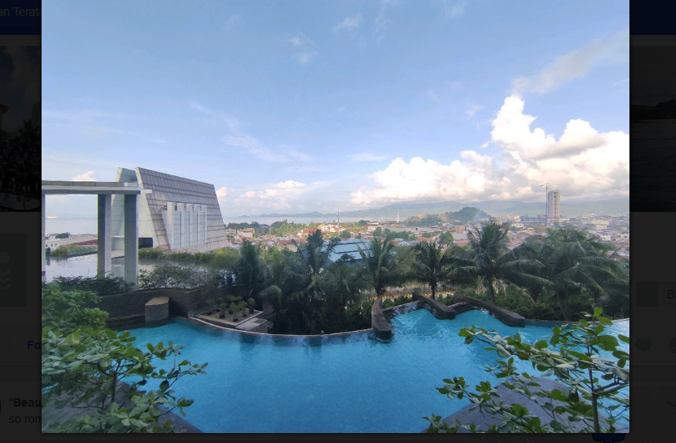
Swimming Pool

Slide 15
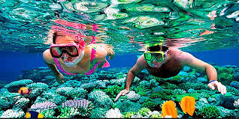
Snorkeling

Slide 16
Look at these examples of guest’s request about facilities:
Is there a……………(sauna at the hotel)?
Which restaurant (..in the hotel gas a western menu)?
Where can we (…..see a good live band)?
I am looking for (……………a hot night club. Do you know of any)?
Where’s a good place (…..to see a movie)?
What is there to do (….here that is different)?

Slide 17
Conversation
Guest: Excuse me, We are looking good restaurant for dinner?
Staff: What kind of food you interested in?
Guest: Since we are in Thailand, we want to try Thai food
Staff: The Thai thai restaurant is always a good choice
Guest: Thank you so much, We’ll try it
Guest: I need to check my email. Is there an Internet café near here?
Staff: Certainly sir, the business center at the hotel has internet access
Guest: Can I also surf the internet there? I need to find some information for a meeting
Staff: absolutely sir
Guest: Ok thank you
Staff: My pleasure sir

Slide 18
Go to amusement park
Go sailing
See a Movie
Where would you go if yo wanted to
Go to eat
See buddist temple
Go shopping
See historical sites
Go surfing
See animals
See the beauty of nature

Slide 19
☺ END ☺

